Slide 1
Southern Water Corp. Case Study
Presenting: Michelle Stevens

Slide 2
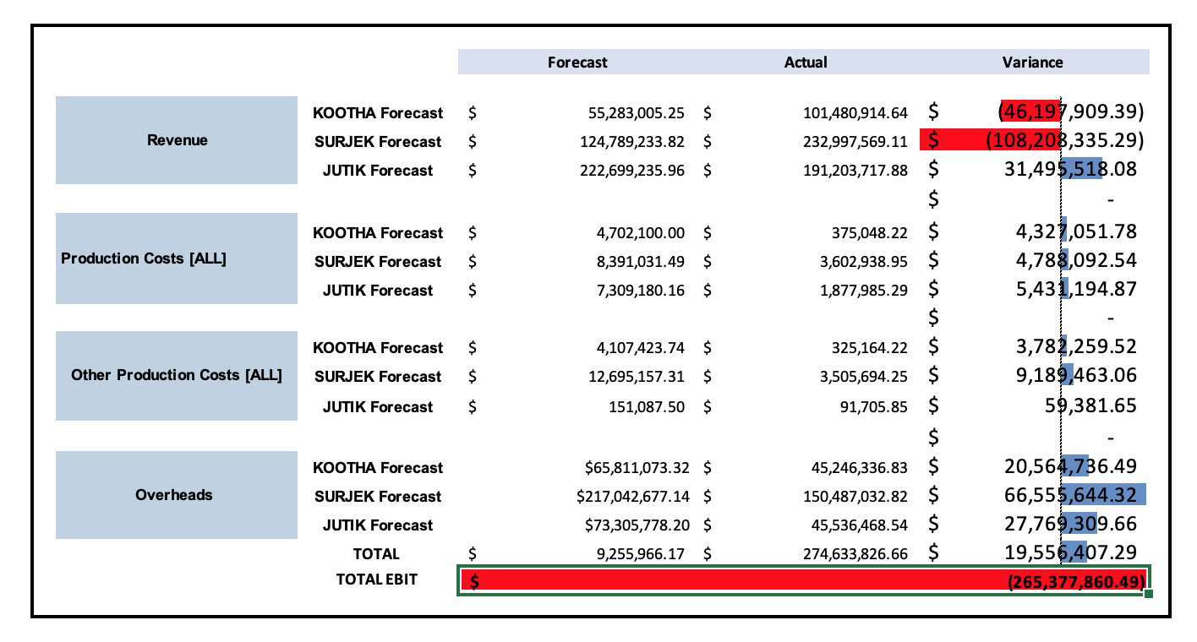
The detailed Revenue Variance displayed that $122M Revenue decrease and $142 cost increase contributed to the $265M EBIT
Positive var.
Negative Var.
Actual vs Budget PL variances, YTD, $m

Slide 3
The major maintenance events forecasted for 2014 caused a negative impact on the forecast revenue, $122M decrease
Notes:
As we talked in the last meeting

Slide 4
The Four Month Maintenance cost have increase significantly which will reduce water production and increase production costs on a per liter basis Average (Increased Cost) difference of $1.2M specially during Sep - March

Slide 5
From the Rolling Year to date, Cost to produce Evidences an average monthly growth of 3%(Forecast) , At the current trajectory, growing in Average $1,68($/Mega-Litre) every month (Forecast)

Slide 6
COST CURVE
From the following Cost-Curve, we can see that it would make sense to dispatch Surjek, for being over the average evaluated into the Market price and in respect to the Overall Weighted $/Mega-Litre.
Surjek has 48% higher price in compare to the others.
Cost Curve Highlighting Cost to Produce versus Market Price
Notes:
2-Create a slide highlighting the overall Cost-Curve showing the Cost-to-Produce for both July 2013 – June 2014 alongside the July 2014 – June 2015 Cost-to-Produce figures along with the respective weighted $/ML prices. ● Create a headline highlighting your recommendations for the most cost-effective economic dispatch of the units based on the $/ML price ● Plot the overall Cost-Curve for July 2013-2014 through to July 2014-2015 ● Ensure that the Cost-Curve is arranged from least expensive to most expensive (use the provided exemplar as a guide) ● Calculate the $/ML price for both 2013-2014 data (which has been provided) as well as the 2014-2015 $/ML market data (as per the Economics OWM Data) and plot this in the Cost-Curve Note: You can create the Cost-Curve in Tableau but this will be very time consuming and is not recommended. If you’d like to learn more, check out

Slide 7
2015 Forecast had the EBITDA added up to $40M total (July-Dec/2014)
Forecast 2014-2015, will finish $9M posivite ↑
Notes:
1-Earnings Before Interest, Taxes, Depreciation, and Amortization – EBITDA

Slide 8
158% Cost Increase Forecast 2014-2015 in Compare to the Actuals 2013-2014
Totalizing the Expenses difference of a growth of $145M
$110M Cost Difference in 2014 to 2015 Cause by the upcoming major maintenance events forecasted for 2014
Notes:
Overall Operating Expenses : Production Costs + Other Production Costs + Overheads

Slide 9
Overall Forecast JAN-APR adds up to -$44M in contrast to $43M total

Slide 10
Revenue Analysis: Financials

